Slide 1



Kowsalya D - Portfolio
Author: dhanam
Created with Pi

Slide 2

CONTENTS
1. Introduction
2. Skills
3. Projects
4. Education
5. Certificates
6. Hobbies
7. Contact
8. Social Links
9. Footer

Slide 3


Introduction
01

Slide 4
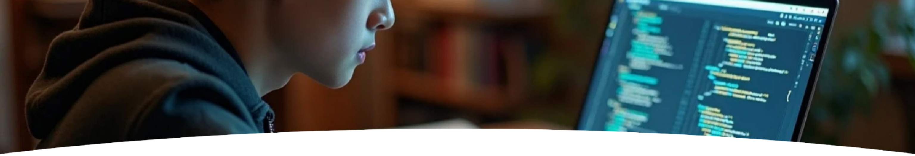
About Me
I am a passionate computer science student who loves coding, problem solving, and creating web applications. I am eager to learn new technologies and improve my skills.

Slide 5
02
Skills

Slide 6






Skills
HTML
CSS
Python
JavaScript
C Programming

Slide 7

Projects
03

Slide 8

Portfolio Website
A personal portfolio built with HTML & CSS.
Student Management System
A simple Python project to manage student details.
Weather App
Web app using JavaScript API to show live weather updates.

Slide 9

Education
04

Slide 10

B.Sc Computer Science
XYZ College, 2022 - Present
Higher Secondary (HSC)
ABC School, Completed in 2022

Slide 11

Certificates
05

Slide 12
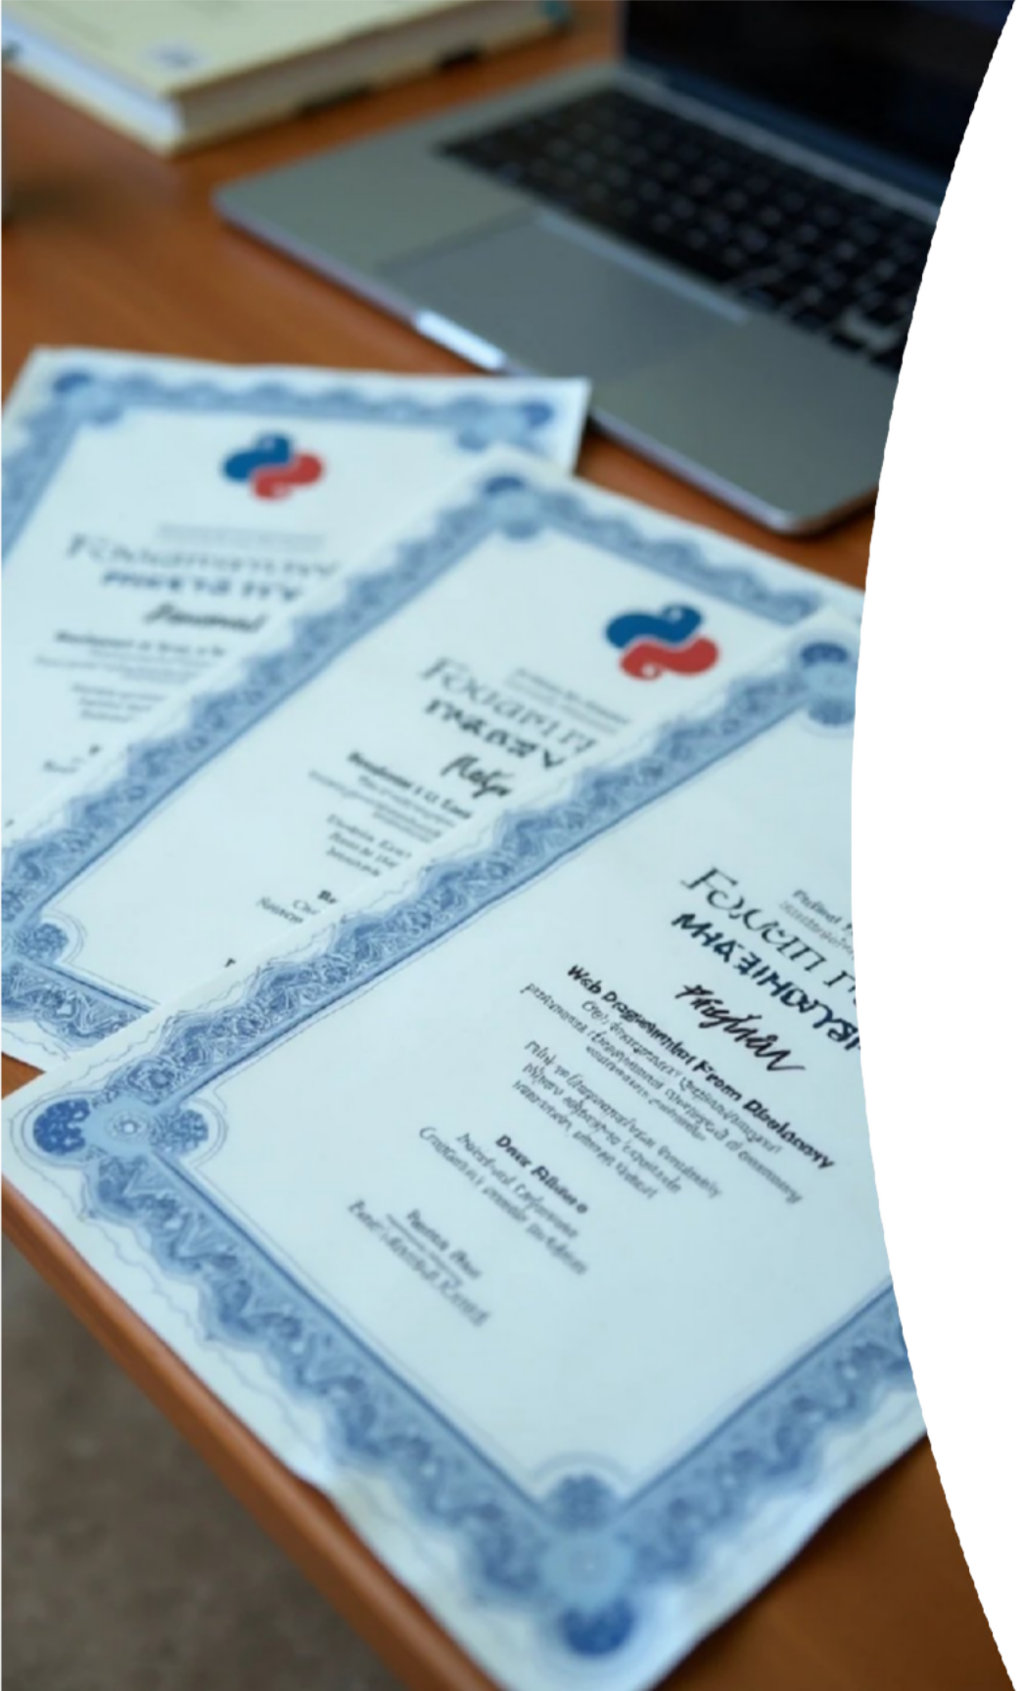



Certificates
Python Programming: Coursera
Web Development: Udemy
C Programming Workshop

Slide 13

06
Hobbies

Slide 14




Hobbies
Exploring new tech
🌍
Reading books
📚
Drawing & Designing
🎨

Slide 15

07
Contact

Slide 16

Contact
Email: Kowsalyadhamodharan123@gmail.com

Slide 17
Social Links
08

Slide 18




Social Links
LinkedIn
GitHub
Twitter

Slide 19
09
Footer

Slide 20

Footer
© 2025 Kowsalya.D. All rights reserved.

Slide 21
Thank You

